Slide 1
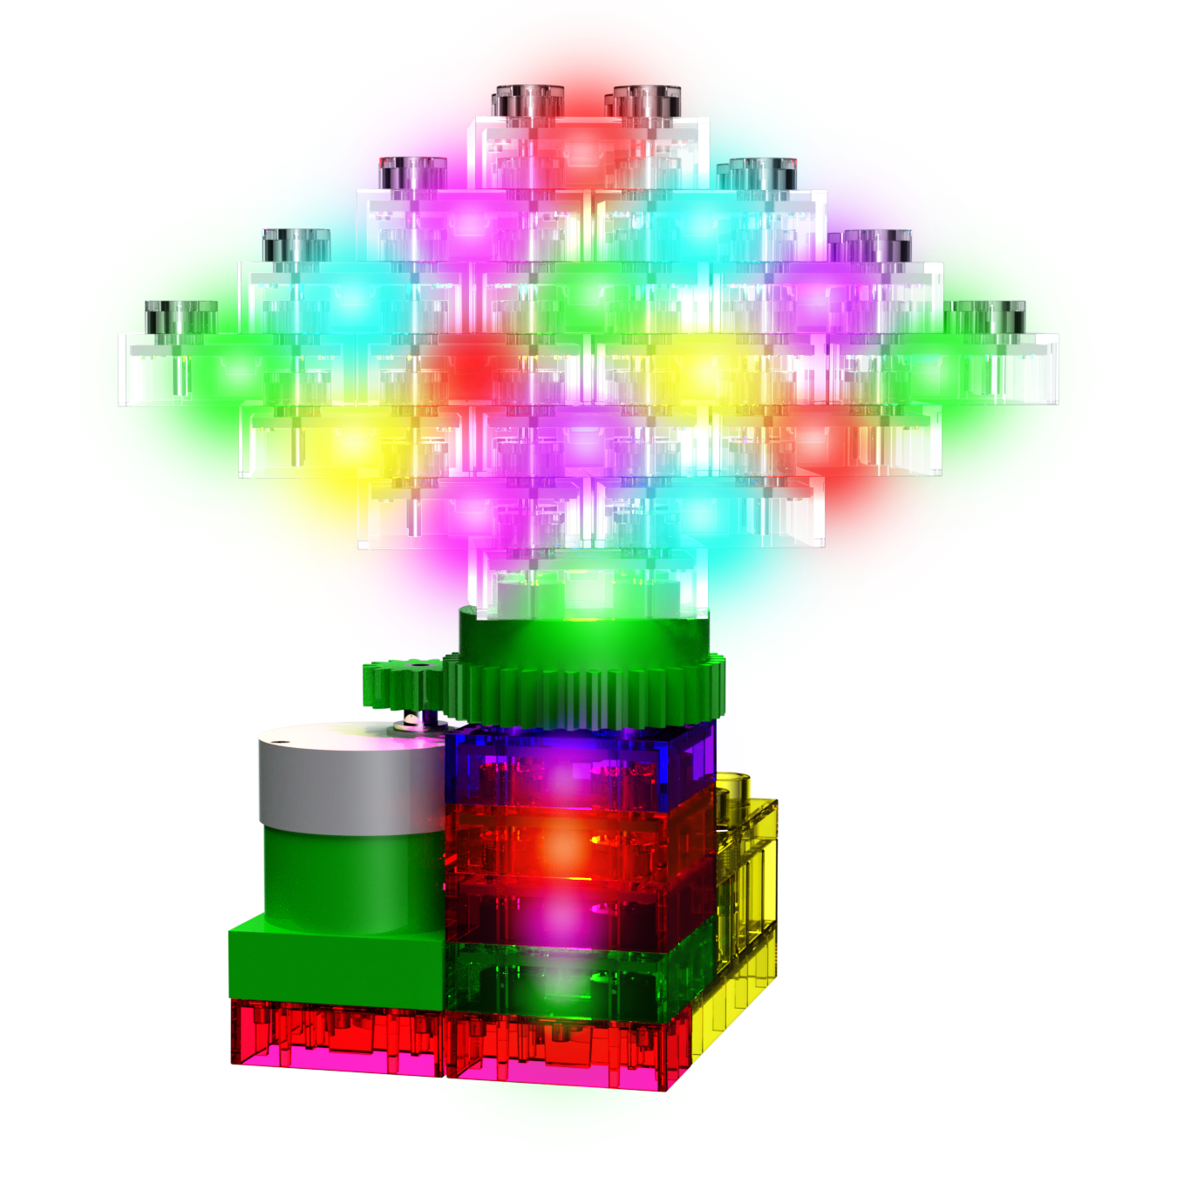
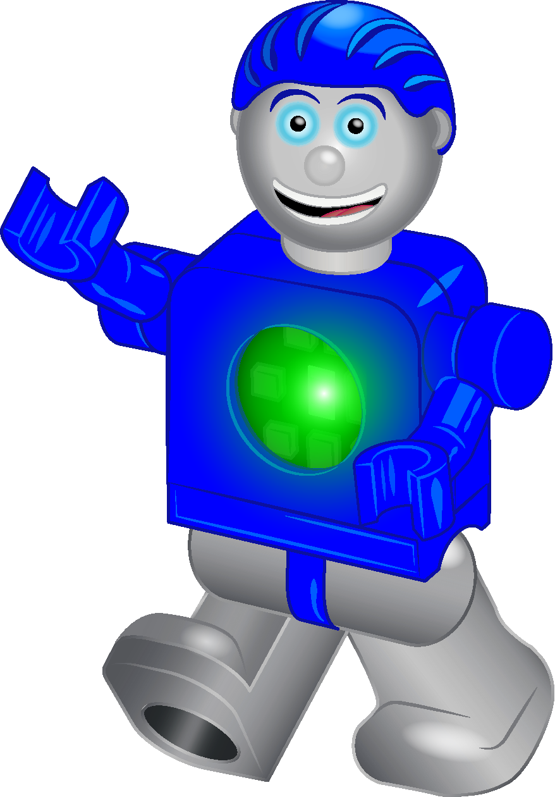
E-Blox Student/Teacher Guide
BUILD IT POWER IT LEARN IT
®
for
Circuit Blox Lights ‘N Motion
K-2nd Grade: STEM Foundations
Seymour Says: E-Blox are STEMsational!!!
Copyright © 2023 E-Blox®, Inc. All rights reserved.

Slide 2
How to Use This Curriculum
This Curriculum has 4 lessons that teach early STEM learning.
It is recommended that the Lessons be taught in order, but can be taught in any order at the preference of the instructor.
This Curriculum can be viewed or presented in any of the following manners:
If viewing on PC with Windows PowerPoint
Make sure you clicked the link for PowerPoint Format (PowerPoint - E-Blox Circuit Blox Lights ‘N Motion Student Guide.pptx)
Make sure to be in Slide Show mode when viewing/presenting
If viewing on Android, iOS or Chromebook device using Google Sheets
Make sure you clicked the link for Google Slides Format (Google Slides - E-Blox Circuit Blox Lights ‘N Motion Student Guide)
Make sure to hit Present or the Play Arrow ( )
If no computer/device or internet is available
Lessons can be printed and handed out to students

Slide 3
How to Use This Curriculum
Each Lesson begins with some background material on the subject and lists the Next Generation Science Standards (NGSS) that are covered by the lesson.
Either read through this material and present/teach it to the class, or
Have the students read through this material and ask questions
The table on the following slide summarizes which lessons teach which NGSS requirements
The next part of each Lesson walks through building exercises to demonstrate the topic.
Have the students take out the correct parts and follow the instructions to build and test things
The next part of each Lesson proposes a fun STEAM project.
Have the students come up with their own solution to the fun STEAM project
The next part of each Lesson has a quiz.
Either print out the quiz and hand out to the students to take the quiz, or
Have the students take out a sheet of paper and write down the answers to each question

Slide 4
NGSS Reference Table
Grade Level | Area | Topic | NGSS Requirement | Lessons
K | Physical Science | Motion & Stability: Forces & Interactions | K-PS2 | Lesson 1
1 | Physical Science | Waves and their Applications in Technologies for Information Transfer | 1-PS4 | Lesson 3
2 | Physical Science | Matter and its Interactions | 2-PS1 | Lesson 1 Lesson 2
K-2 | Engineering, Technology & Science | Engineering Design | K-2-ETS1 | Lessons 1-4

Slide 5
Table of Contents
Curriculum Lessons
Lesson 1 – Building Fundamentals
Lesson 2 – Electricity & Circuits
Lesson 3 – Light
Lesson 4 – Motors & Gears

Slide 6
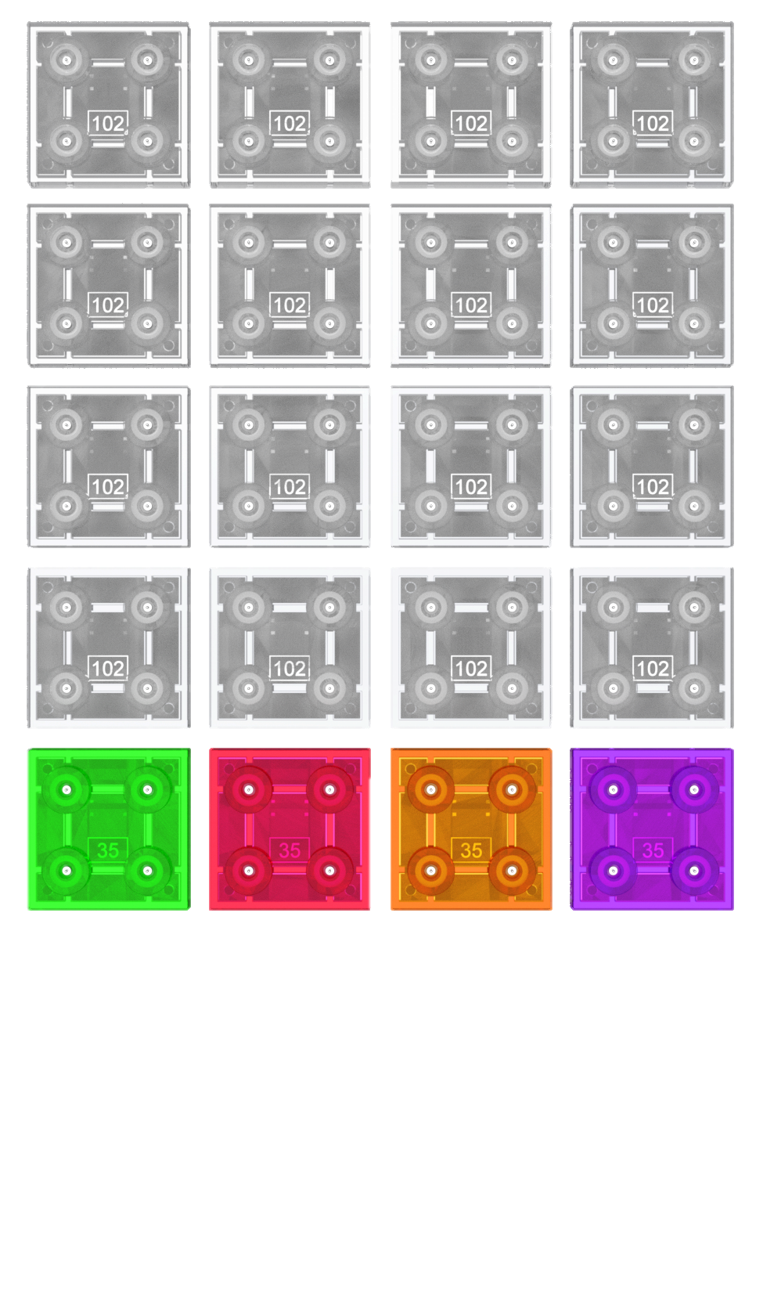
Lesson 1 – Building Fundamentals
Lesson length: 40 Min
Key Learning: Structures & Forces
NGSS Area: K-PS2, 2-PS1, K-2-ETS1
Seymour Says: What is the tallest building?
The library…because it has the most stories!!!

Slide 7
Tower Stability
Get 20 LED blocks and build the tower to the right. When you push the tower at the top is it easy to tilt and fall over?
Push here
Now build the tower to the right? Now when you push the top of the tower, is it more stable?
Push here
Seymour Says: Tall buildings must be designed to prevent wind from making the building tilt and fall over.

Slide 8
Tower Stability
On Earth, gravity is a force that pulls objects towards the center of the Earth.
Tilting the tall tower slightly creates large gravitational forces near the top & small gravitational forces near the bottom, making it more likely to fall over.
Tilting the smaller tower slightly leads to large gravitational forces on the left pulling it back in place & only small gravitational forces on the right, make it less likely to fall over.
Small force from gravity
Large force from gravity
Seymour Says: Tall buildings must be designed to account for the effects of gravity.
Large force from gravity
Small force from gravity

Slide 9
Bridge Stability
Build the bridge shown below? Now push in the center of the bridge as shown. Does the bridge start to bend and nearly collapse?
Pushing the center of the bridge creates forces called Compression and Tension on the bridge.
Push Here
Seymour Says: Bridges must be designed to prevent Buckling (too much compression) and Snapping (too much tension) so they don’t collapse.
Compression
Tension

Slide 10
Bridge Stability
Now build the bridge shown below? Again push in the center of the bridge. Does the bridge feel more stable now?
Compared to the previous bridge, this bridge reduced the Span between the Bridge Supports and added Reinforcement blocks.
Push Here
Seymour Says: Reducing Span between the Bridge Supports and adding Reinforcements are ways to address the issues of compression and tension.
Reinforcements
Span
Bridge Supports

Slide 11
Bridge Reinforcements
Suspension
Truss
Seymour Says: Suspension, Truss, Cable-Stayed and Arch are all reinforcement techniques used in bridges. The RED areas show where there is reinforcement.
Cable-Stayed
Arch

Slide 12
Fun STEAM Excercise
Find a non-breakable object that is about 5 pounds in weight. Try building a bridge that can hold the 5 pound object.

Slide 13
Lesson 1 Quiz
Q: What creates a force pulling objects towards the center of the Earth?
Q: Which of the follow towers is least stable and most likely to fall over?
A. B. C.
Q: Which of the following is NOT a type of reinforcement used in bridge design?
A. Tension B. Suspension C. Truss

Slide 14
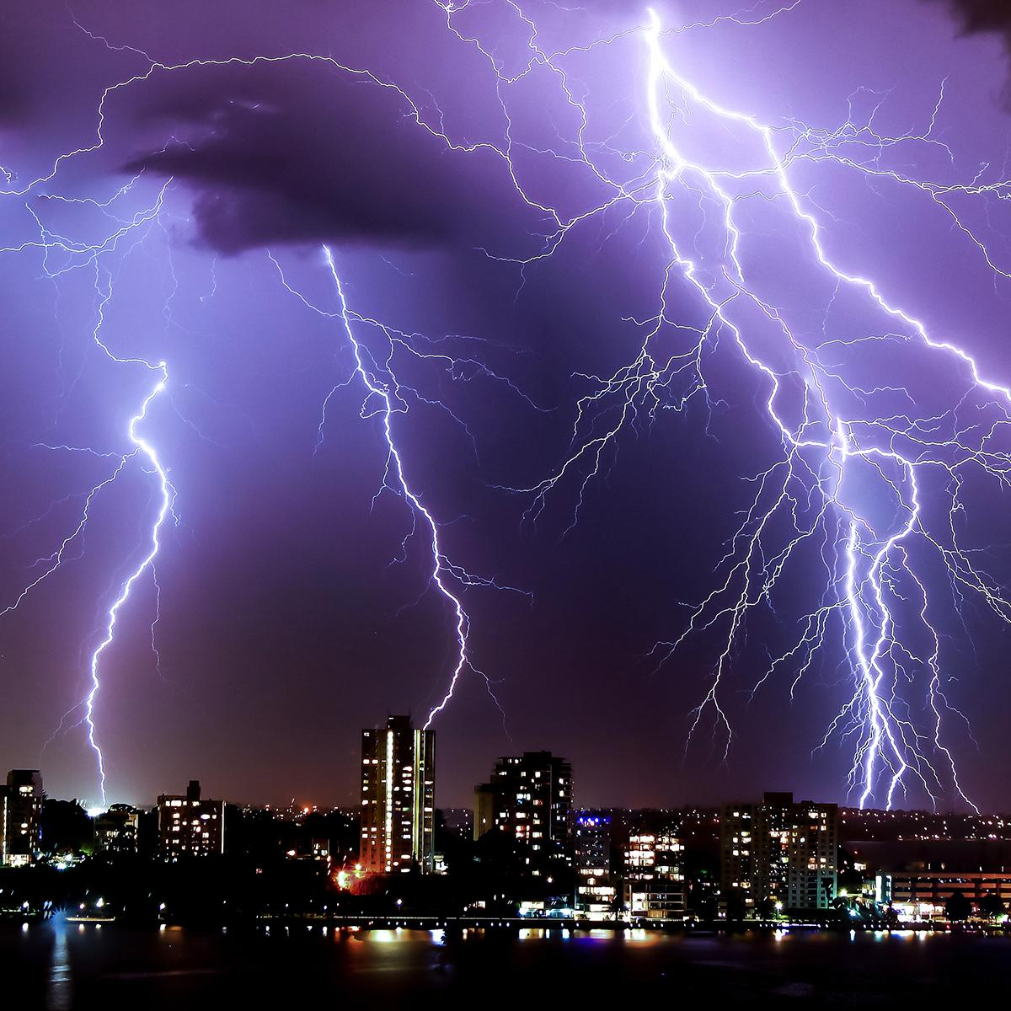
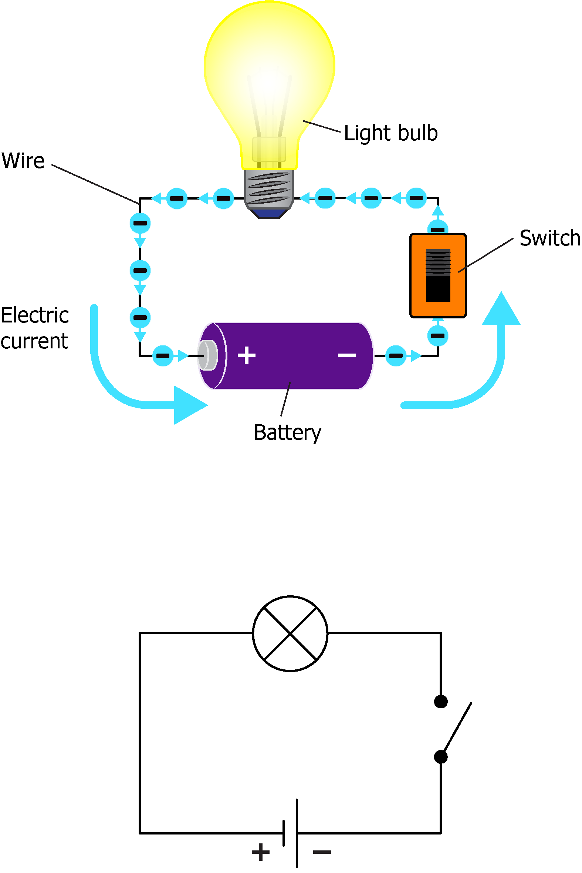
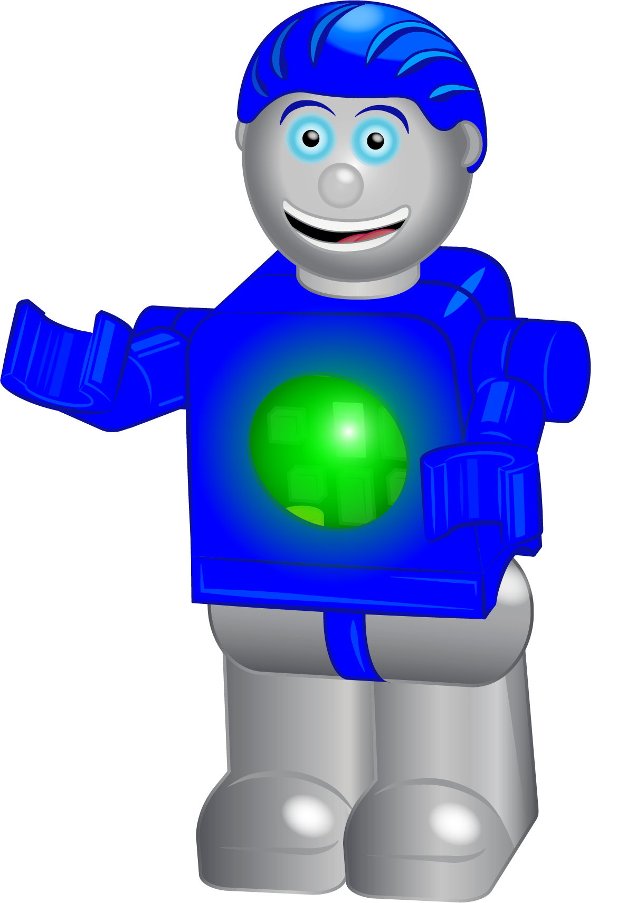
Lesson 2 – Electricity & Circuits
Simple Circuit
Lesson length: 40 min.
Key Learning: Closed loop circuits,
short circuits
NGSS Areas: 2-PS1, K-2-ETS1
Seymour Says:
When I learned how electricity actually works, I was SHOCKED!

Slide 15
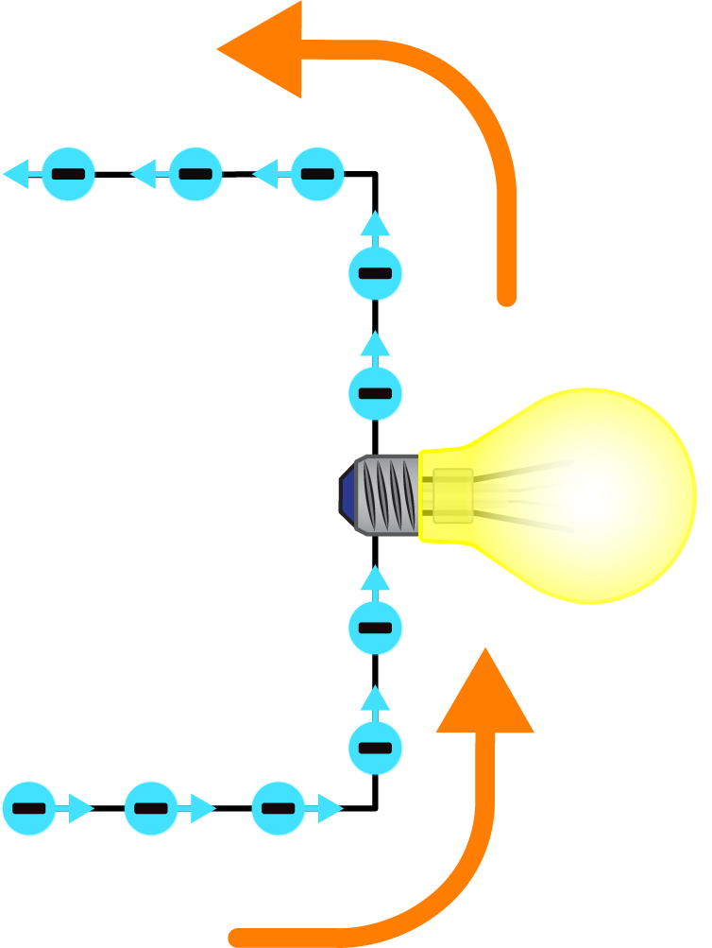
What is Electricity?
Electricity is the flow of electrons, or the flow of electric charge.
Electrons are part of very tiny particles called atoms that make up all things.
Seymour Says:
Did you know that Electricity travels at the speed of light? That’s more than 186,000 miles per second!
Electrons are negatively charged, and certain electrons can move from atom to atom when an external force is applied.
As shown in the diagram to the right, electrons flowing through a conductive material (like a wire) leads to electricity.
Electrons flowing

Slide 16
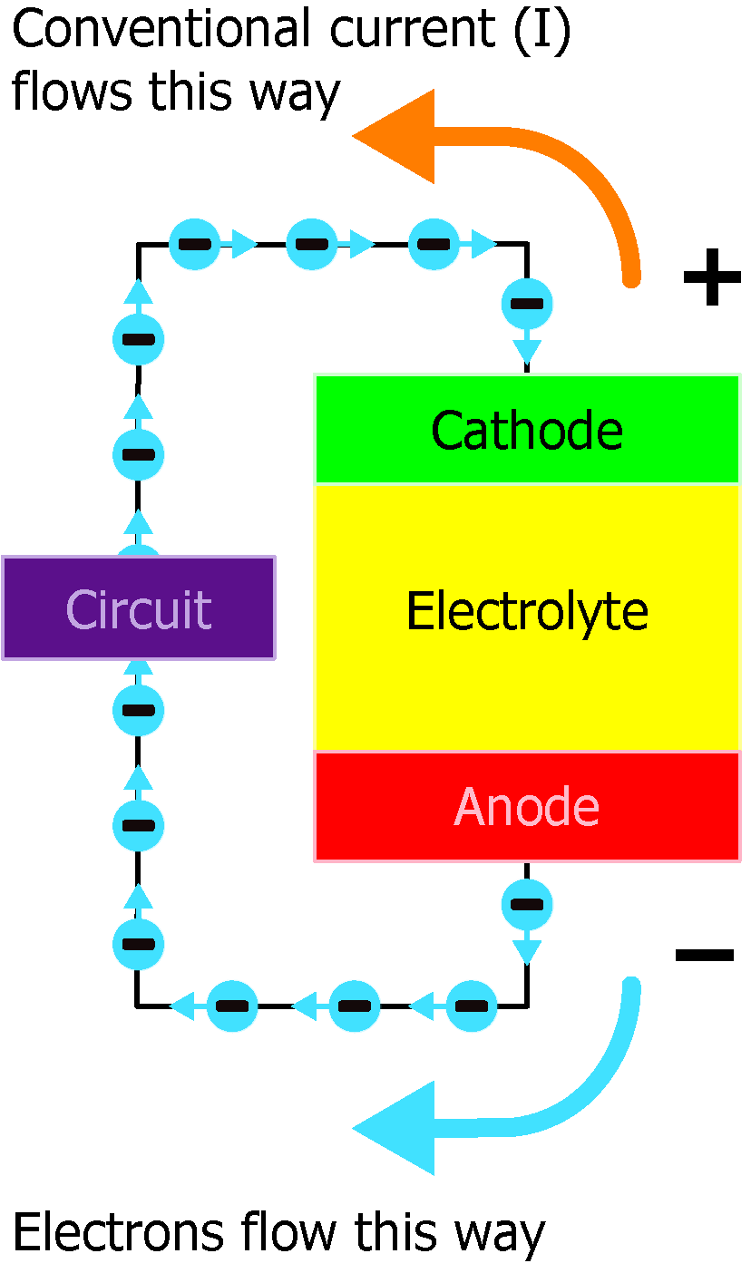
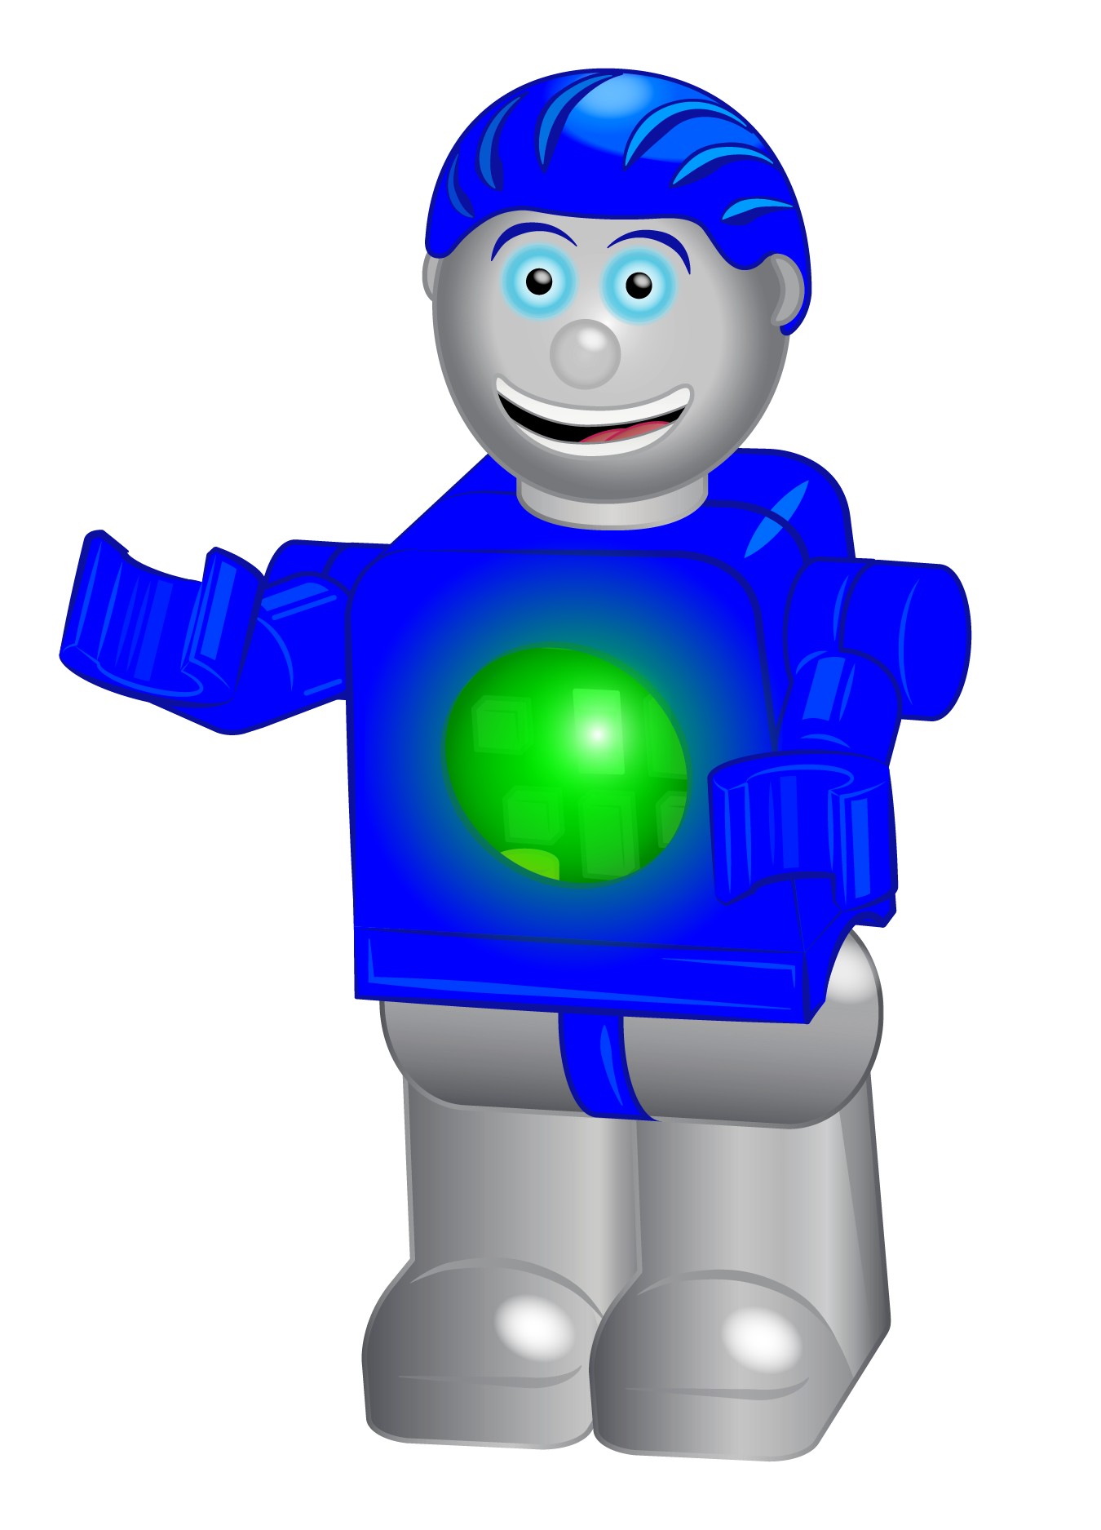
Batteries – the External Electrical Force
In order to force electrons to move in a circuit and create electricity, an external electrical force must be applied.
Batteries provide this electrical force to move electrons through the circuit.
Seymour Says:
Batteries can only create the build up of electrons when in a circuit for a period of time and then they drain. So always turn off or disconnect your circuits when you take a break from your Circuit Blox set so that your batteries do not drain.
Batteries have three parts, an anode (–), a cathode (+), and the electrolyte, as shown in the figure to the right.
When the cathode and anode are hooked up to an electrical circuit, a chemical reaction occurs in the battery causing an electrical force on electrons out of the Anode.
When this happens, conventionally it is said that “positive” current is flowing from the cathode to the anode (while “negative” current or electrons flow from anode to cathode).
The amount of pressure that the battery provides to move electrons is related to the Voltage of the battery.
Higher Voltage means more pressure to move electrons and lower voltage means less pressure to move electrons.

Slide 17
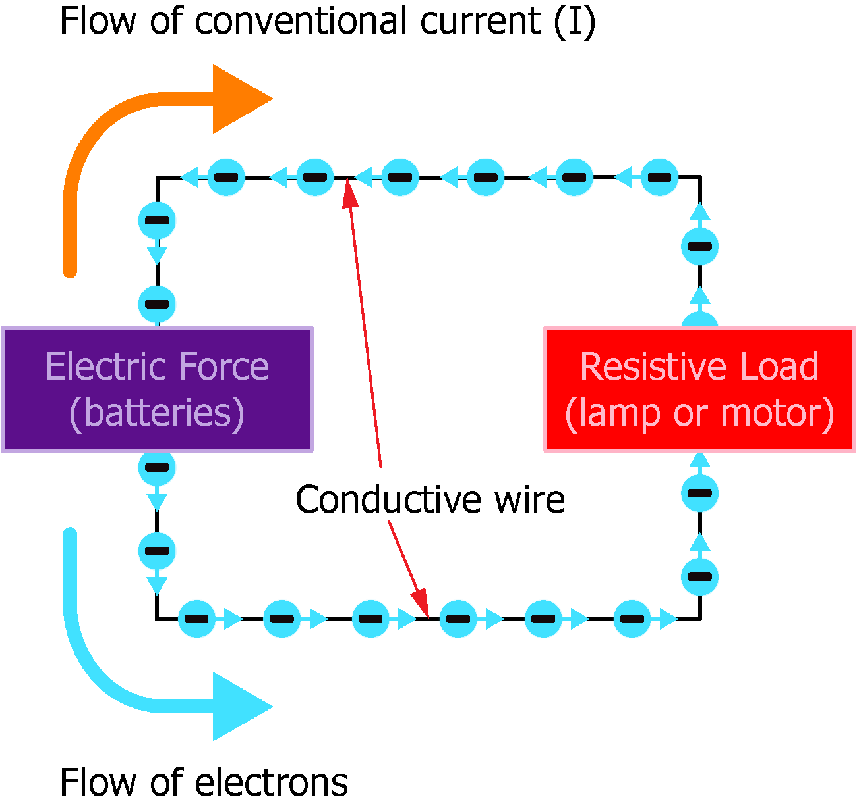
Closed Circuits
In order to create electricity, electrons must be able to flow continuously. This means there needs to be some place for these electrons to flow with no dead end!
This can be accomplished by creating a loop as shown to the right (a Closed Circuit).
Batteries provide electric force to the loop to get the electrons moving. When electrons are moving like this, we say there is an electrical current flowing.
IMPORTANT: There needs to be some form of Resistive Load (example: lamp or motor) in the loop to prevent the electrons from circling too quickly (which could be dangerous…see the slide after the next one).
Seymour Says:
This study guide uses the conventional definition of current, sometimes called the positive flow of current, which is in the opposite direction of the flow of electrons.

Slide 18
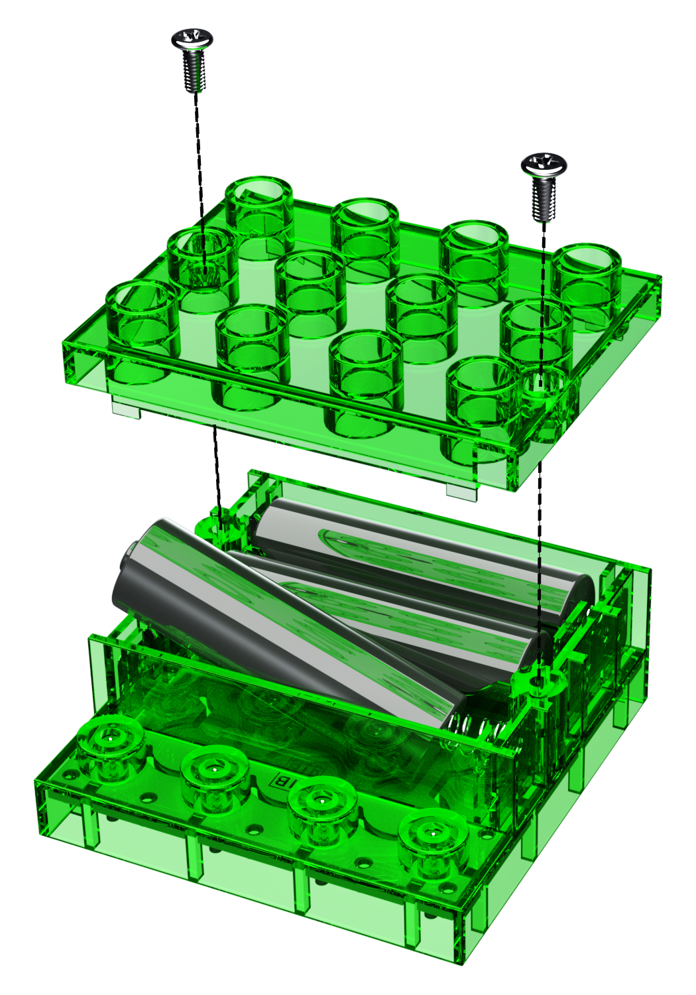
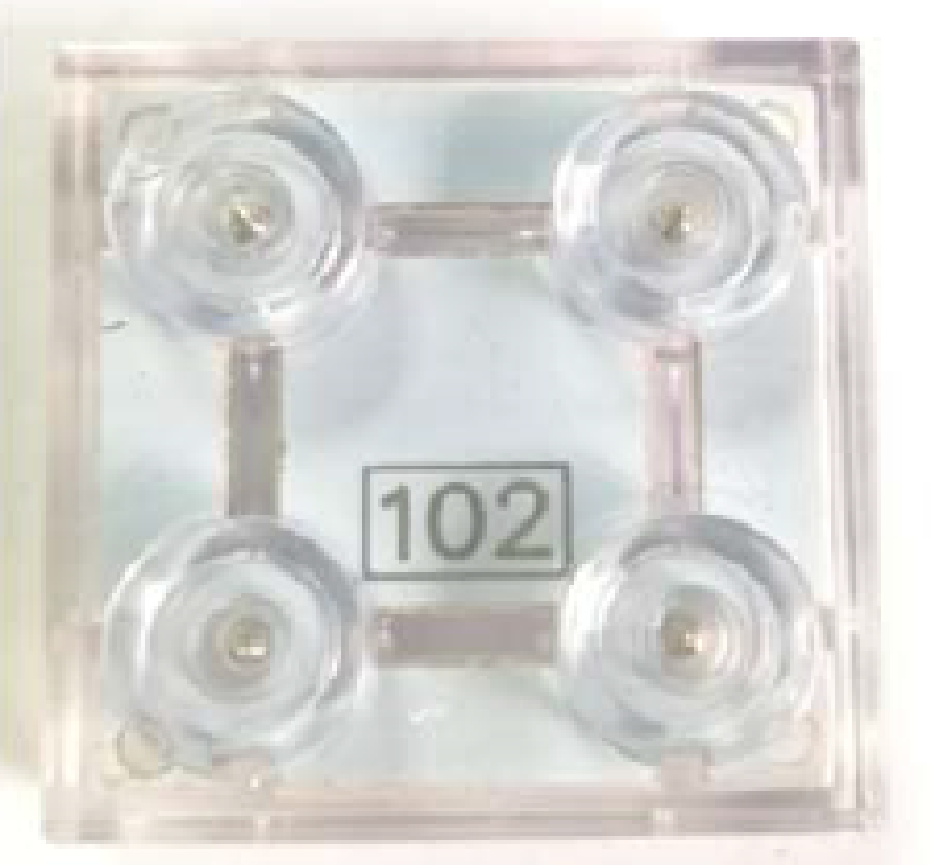
Creating Your First Closed Circuit
From your Circuit Blox Light ‘N Motion set, find the modules shown below.
Place cover on the Battery (91B) module after inserting batteries and secure screws
Insert the batteries as shown making sure the polarities are as shown inside the Battery Module (91B).
Insert three (3) “AA” batteries
Seymour Says:
The Pin connectors in your parts make electrical connections to create circuits!
+
–
+
–
Battery (91B)

Slide 19
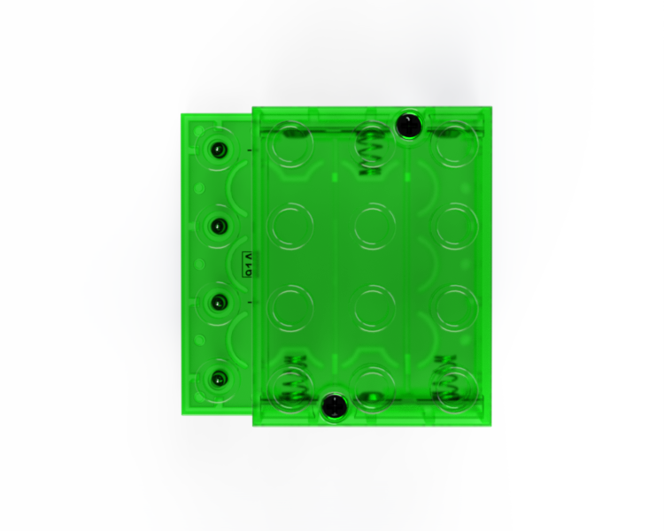
Creating Your First Closed Circuit
Build the circuit shown.
Seymour Says:
An electrical “loop” is always needed between the “+” and “-” terminals of the battery to enable current to flow.
As you connect the LEDs #102, what do you observe?
Connecting the LEDs (102) to the “+” and “-” of the battery (91B) makes a closed circuit.
This allows electrons to flow through the LEDs (102) which makes them light.
Take the LEDs (102) out of the circuit. What do you observe?
Removing LEDs (102) opens the circuit in certain places, so there is no loop for current to flow from the Battery (91B) “+” terminal to the Battery (91B) “–” terminal.
This stops electrons from flowing through the LEDs (102) which makes the LEDs (102) turn off.

Slide 20
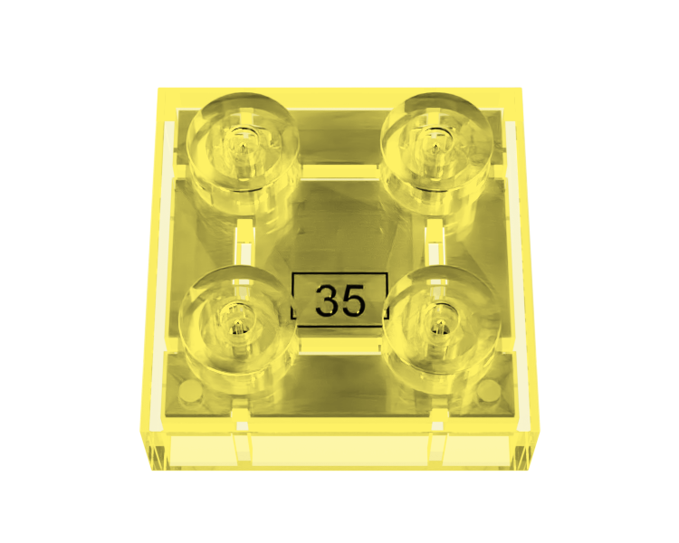
Inside your LEDs #35 and #102
The figure to the right shows a circuit diagram of the inside of your LED modules (35 & 102).
Note there is a 2-way LED between two of the terminals inside the LED module (35 or 102). This LED will light when current flows through it in either direction.
2-way LED
Note that connectors in opposite corners of the LED modules are connected together.
With this design, connecting “+” from and “-” from the battery (91B) to connectors on the LED (35 or 102) side-by-side will cause current to flow through the 2-way LED and light the 2-way LED.
This design also allows power to be passed through the LED module (35 or 102) to other LED modules (35 or 102).
Seymour Says:
Make sure at least one pair of side-by-side connectors on the LED modules (35 or 102) is connected to “+” and “-” from the battery (91B) to make the LED will light.
As long as you make 2 sid-by-side connections between the LEDs (35 and 102) and the Battery (91B), then current will be able to flow through the 2-way LEDs in the LED modules (35 and 102) and the LEDs will light.
If only one connector on the LED module (35 or 102) is connected to the battery (91B) or only a pair of opposite corner connectors are connected, then current cannot flow through the 2-way LED and the LED (35 or 102) will not light.

Slide 21
Fun STEAM Exercise
Try building a working circuit using as many of the LEDs (102 & 35) in your Lights ‘N Motion set making all of them light.

Slide 22
Lesson 2 – Quiz
Q: Which of the following types of circuits make the lights in your house come on?
A. Closed Circuit B. Short Circuit C. Open Circuit
Q: In which of these circuits will ALL the LEDs (102) be ON?
A. B. C.
Q: Which LEDs will light in the circuit below?

Slide 23
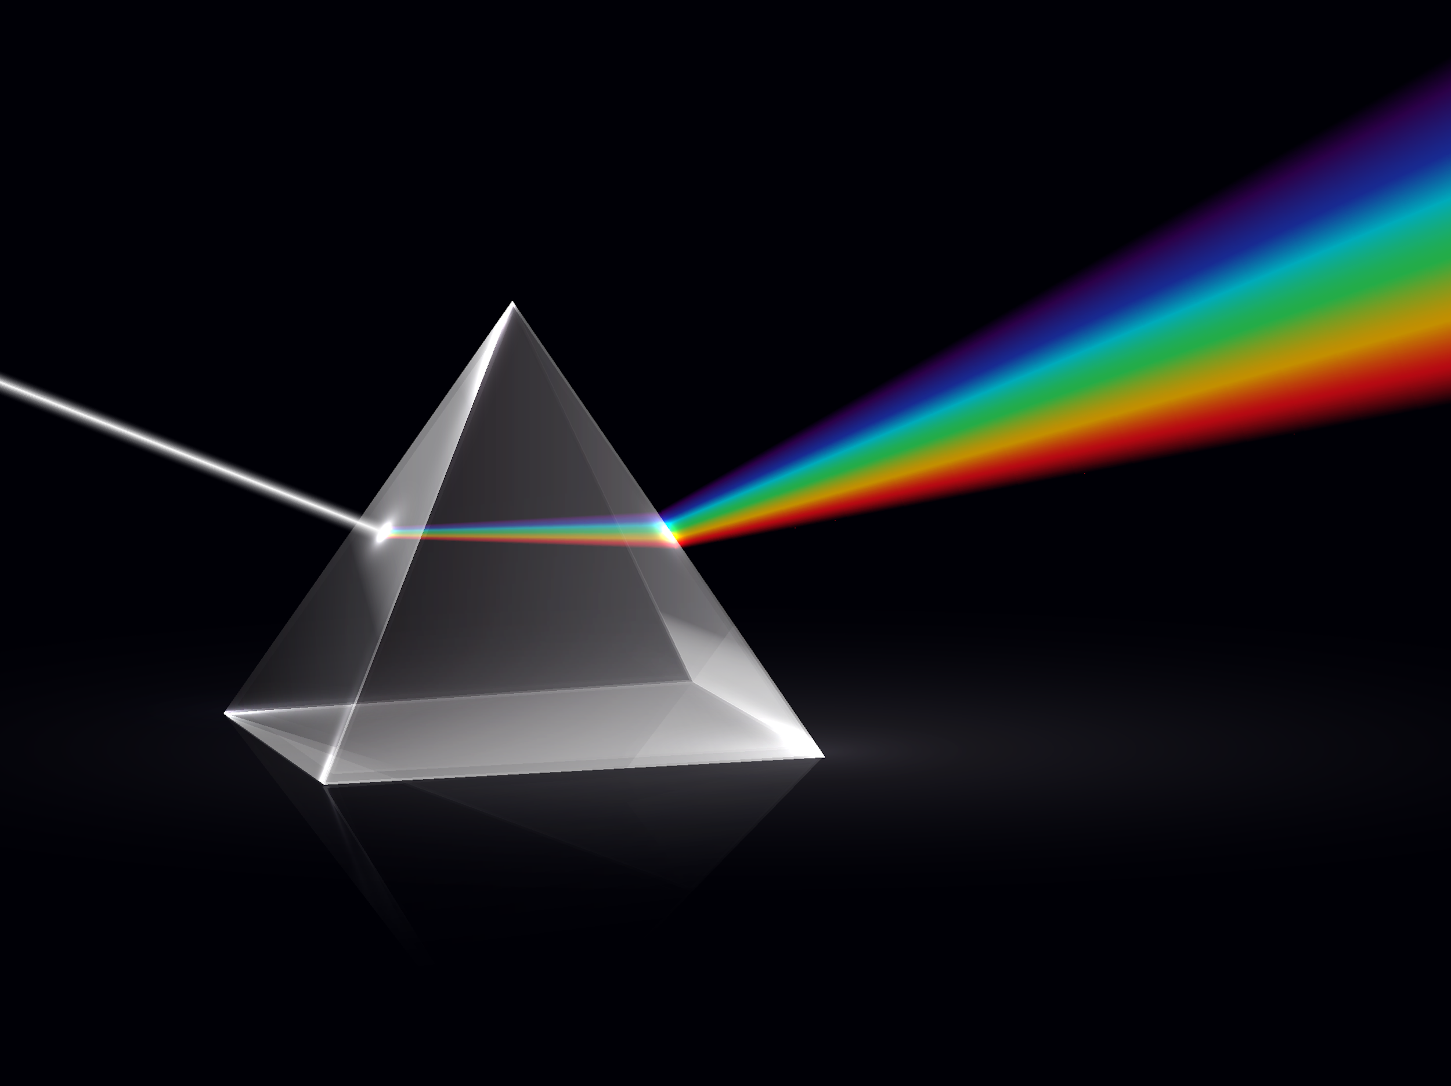
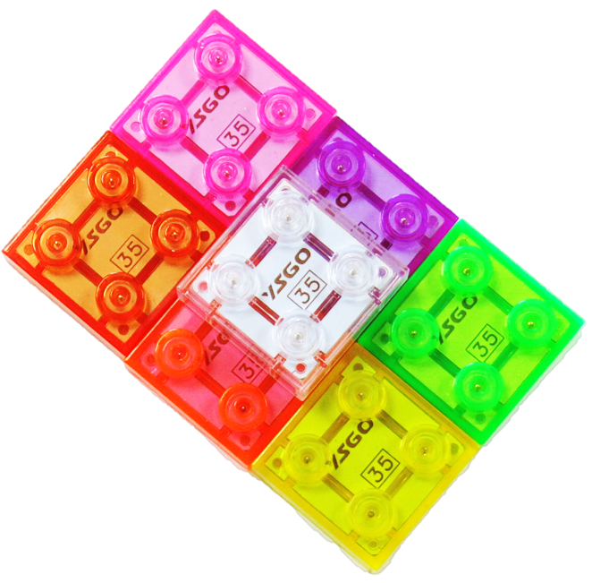
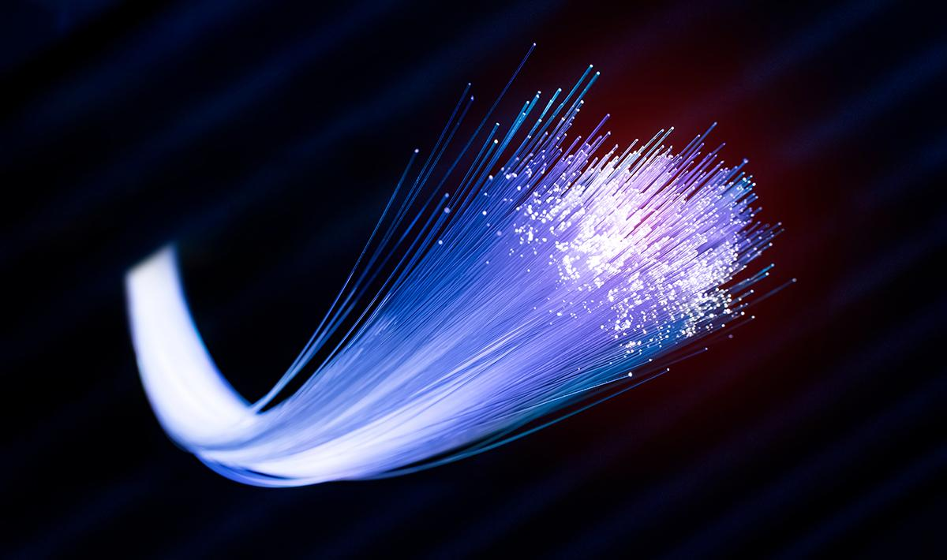
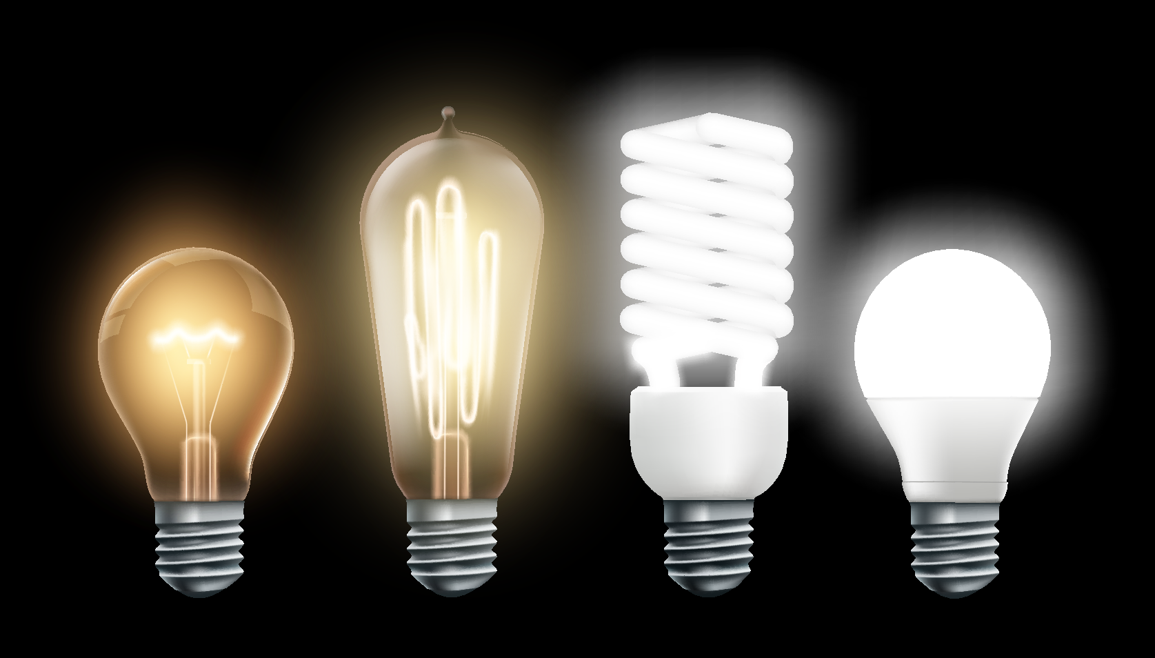
Lesson 3 – Light
Lesson length: 40 min.
Key Learning: Waves, LED vs. Incandescent Light
NGSS Area: 1-PS4, K-2-ETS1
Seymour Says:
I was LED to see the light?

Slide 24
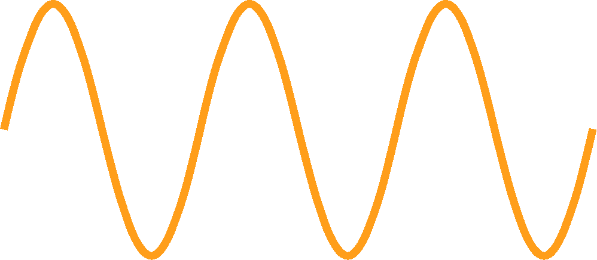
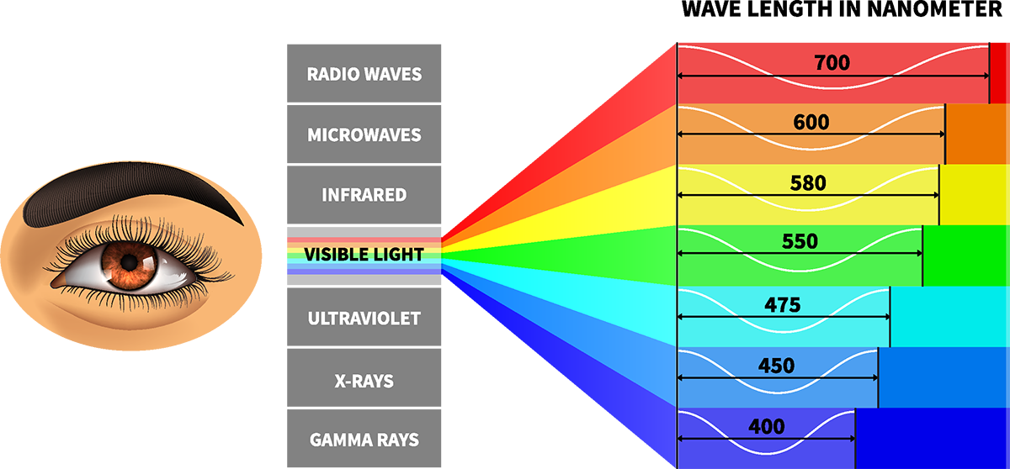
What is Light?
Wavelength
Light is actually a wave that travels through space at a VERY fast speed (300 million meters/second).
You can think of a wave as something like the figure shown to the right.
Amplitude
The Amplitude of the wave is how tall the wave is and determines how bright the light is.
The Wavelength of the wave is the distance between two peaks of the wave and relates to the color of the light.
Not all waves are visible, but visible light waves have wavelengths in the range of 400-700 Nanometers (there are 1 Billion Nanometers in one meter, so a Nanometer is VERY small).
Seymour Says:
Light may sometimes appear to be white to you, which is because white light is made up of many different light waves with different wavelengths.

Slide 25
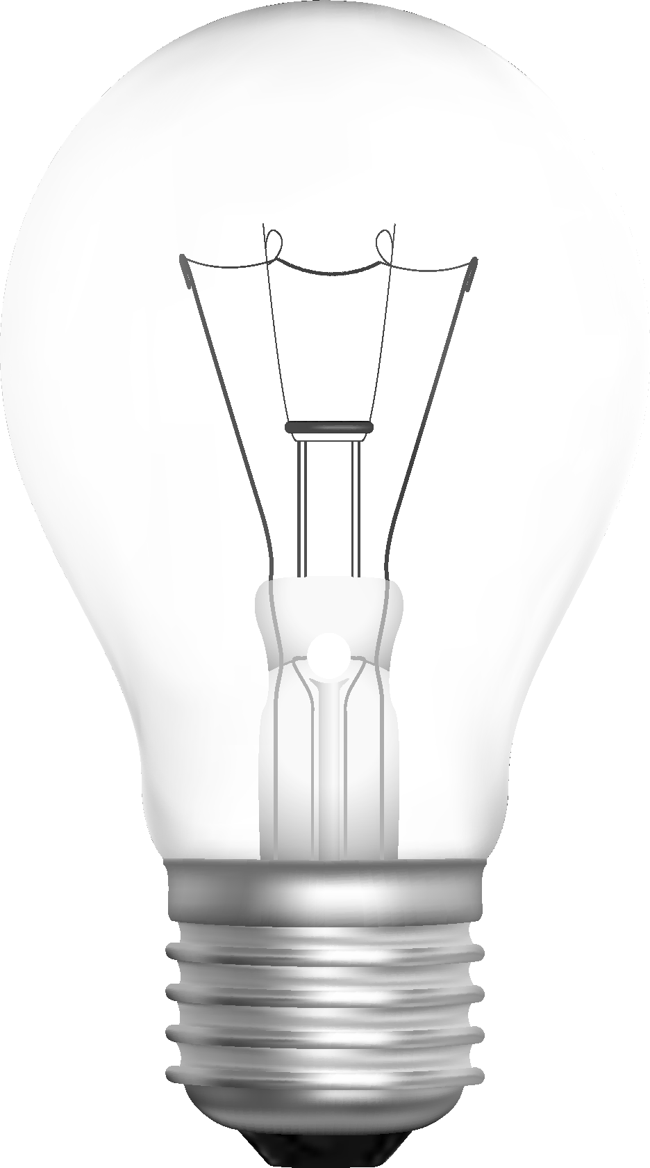
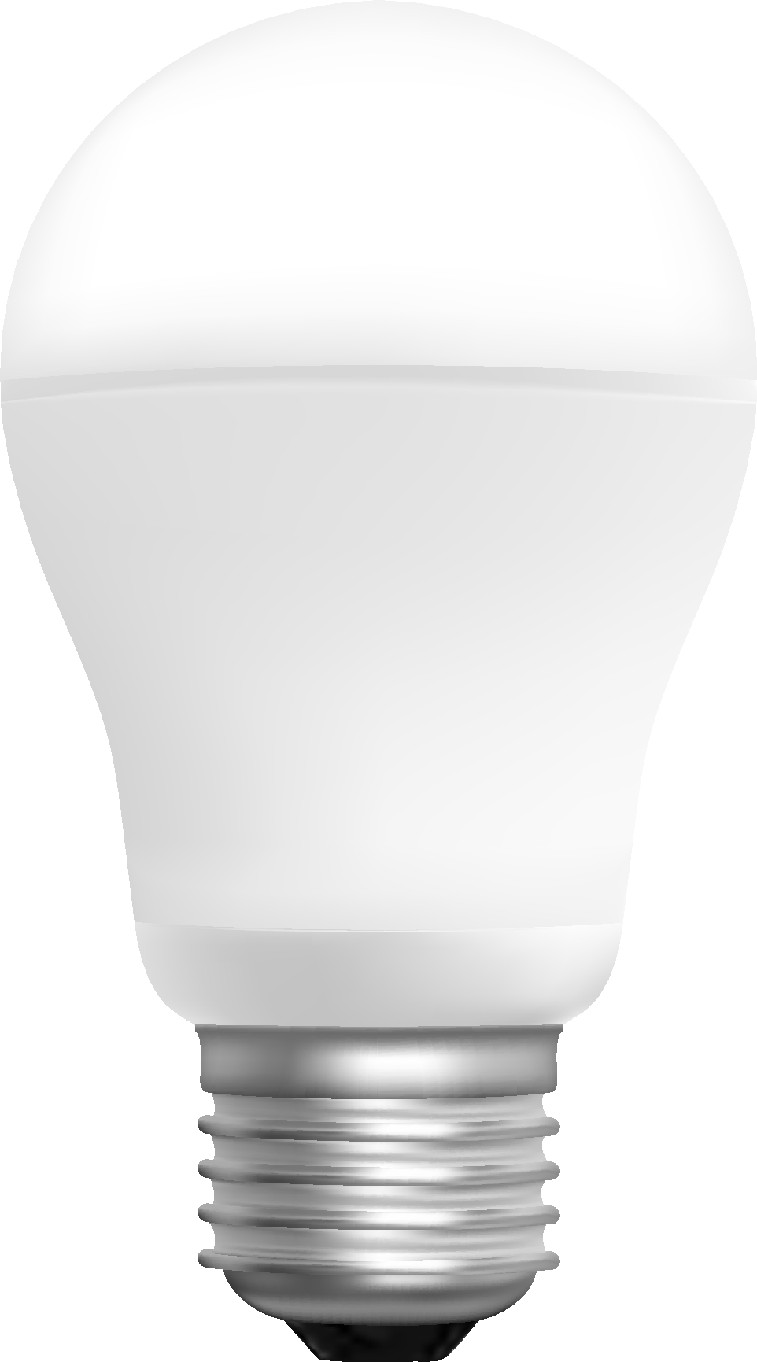
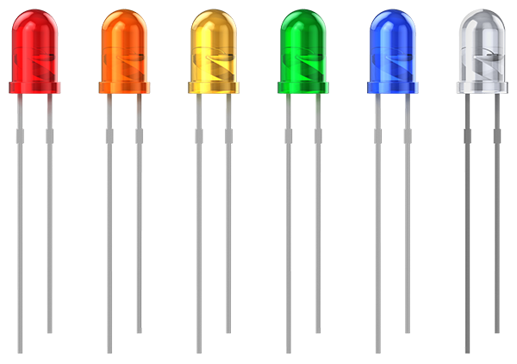
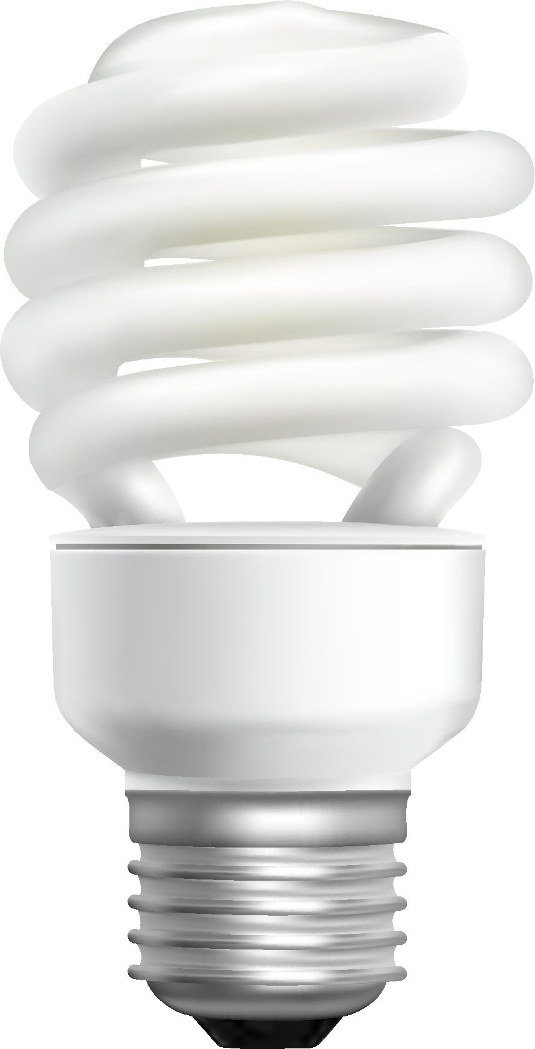
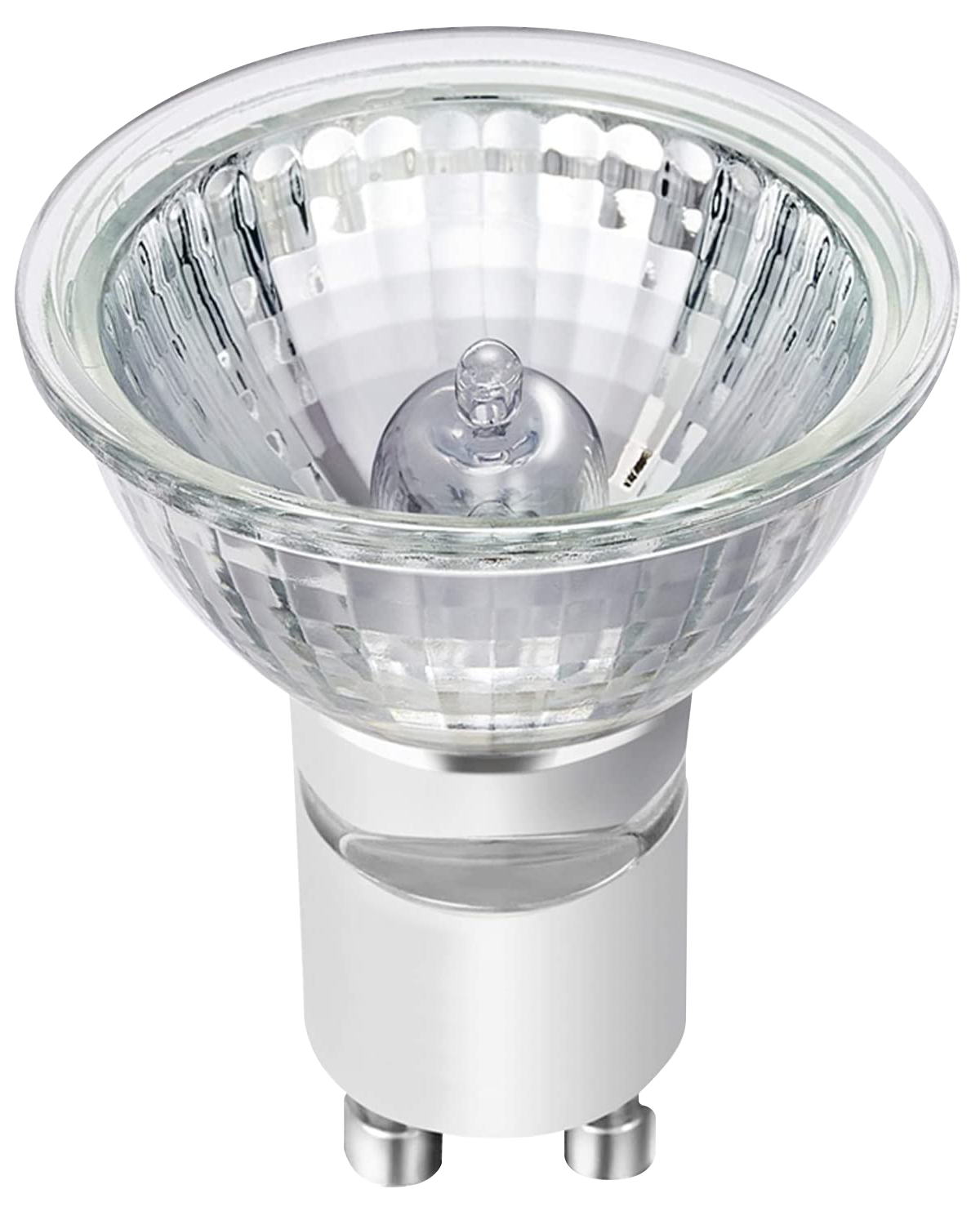
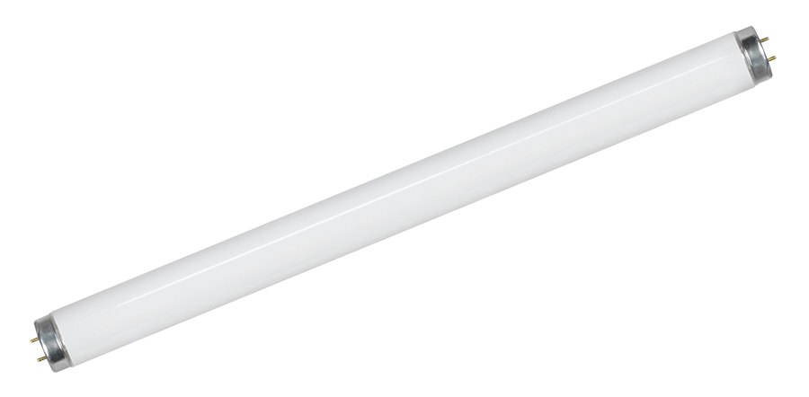
Types of Light
Conservation of Energy is the principle that energy is neither created nor destroyed, but is always converted from one form of energy to another form of energy.
Incandescent Lamp
Light Emitting Diode (LED)
Light is a form of energy, so to create light it must come from another form of energy.
Typically, we create light from electrical energy (current) by placing a “light bulb” in a circuit that makes current flow through it.
There are many different ways we create light, or different types of “light bulbs”, as shown to the right.
Compact Fluorescent
Halogen Lamp
We are going to focus on the incandescent lamp and LED since your Lights ‘N Motion set has parts with these types of lights embedded.
Seymour Says:
The Incandescent Lamp was the first “Light Bulb”, but over the years improved “light bulbs” have been introduced that last longer and are more efficient (produce more light with the same amount of electrical energy).
Fluorescent Tube
Neon Lamp

Slide 26
Light Emitting Diodes (LEDs)
An LED is made of two types of Semiconductor Materials as shown to the right.
Light
Semiconductor material #2 has a larger build up of electrons than Semiconductor Material #1.
Semiconductor Material #1
Semiconductor Material #2
When enough voltage is applied across the LED, electrons flow from Material #2 towards Material #1.
As electrons flow from Semiconductor Material #2 to Semiconductor Material #1, part of their energy is released as light in the gap area.
Gap
Electrons
Current
This is how the LEDs in your Lights ‘N Motion set work.
Your LED modules (35 or 102) contain 2-way LEDs, which you can think of like 2 LEDs side-by-side, each allowing current to flow in the opposite direction. Current can flow in either direction but will make only one of the LEDs light.
LEDs are much more efficient than Incandescent Lamps.
Seymour Says:
Approximately 40-50% of the electrical energy (Current) is converted to Light energy in an LED, and about 50-60% of the electrical energy is still converted to heat energy.
LEDs (35 & 102)

Slide 27
Experimenting with LEDs
Build the circuit shown.
Seymour Says:
LED Module (35) provides a great example of how 2-way LEDs work. When you reverse the direction in which current flows through the LED Module (35), this changes the LED that turns ON underneath the LED module (35).
Notice that the LED (35) is ON.
The LED (35) is ON because current is flowing through one pair of side-by-side connectors which means current is flowing through one of the LEDs that make up the 2-way LED.
Look underneath your LED (35) while it is connected to the battery (91B). You should notice that one of the two LEDs is ON.
Rotate the LED (35) as shown.
Notice that the LED (35) is still on (current is still flowing through one of the LEDs).
Look underneath your LED (35) again and you should notice that the other LED is ON this time.
Note that LED (102) works in a similar way, but the two LEDs are internal to the light emitting circuit that makes the light change colors and flash.

Slide 28
Fun STEAM Exercise
Build a circuit with several of your LEDs (35 and 102) on the Battery Module (91B) and take it into a dark room. Notice how the light reflects off walls and objects in your room, demonstrating the WAVE properties of light.

Slide 29
Lesson 3 – Quiz
Q: Which type of device is more efficient in turning electrical energy into light energy?
A. LED
B. Incandescent Lamp
Q: True or False: both LEDs and 2-way LEDs only allow current to flow easily in one direction to make them light?
Q: Which of the following most directly impacts the color of light?
A. Amplitude B. Current Flow C. Wavelength

Slide 30
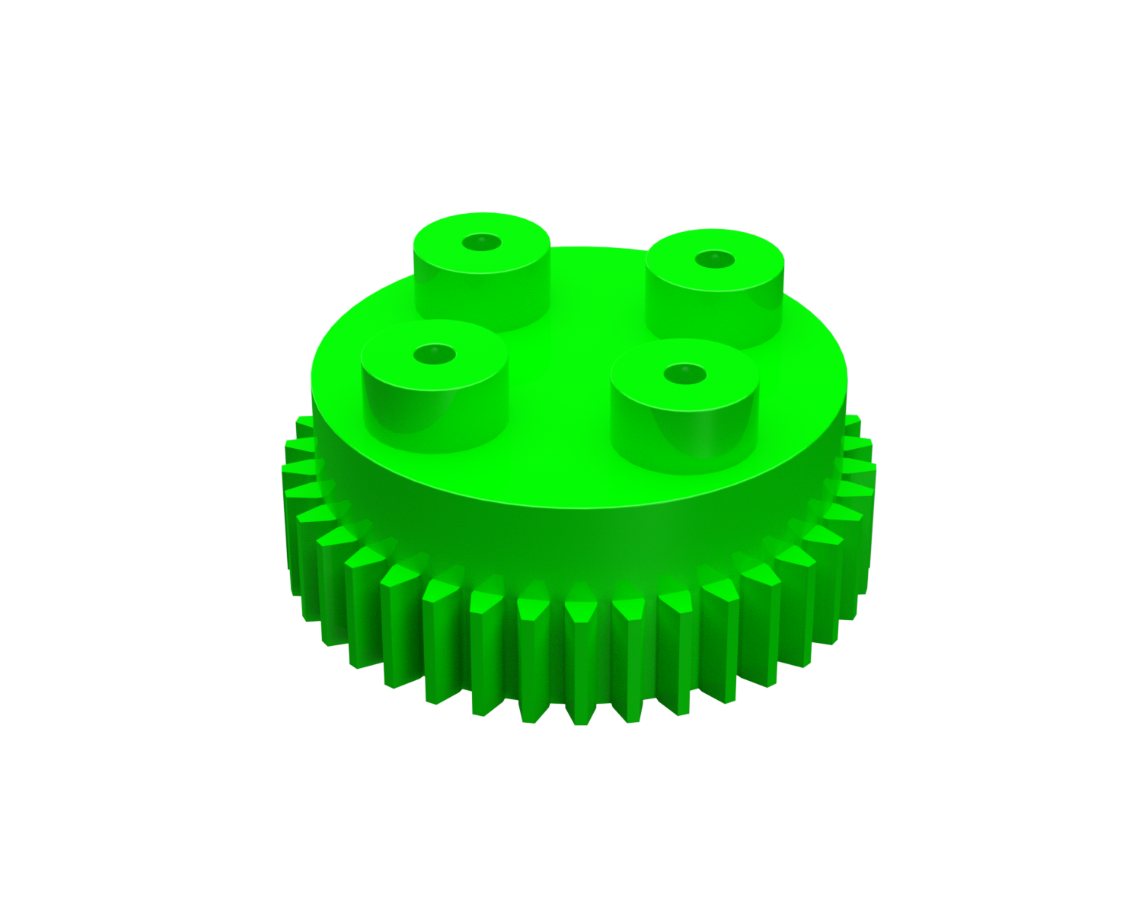
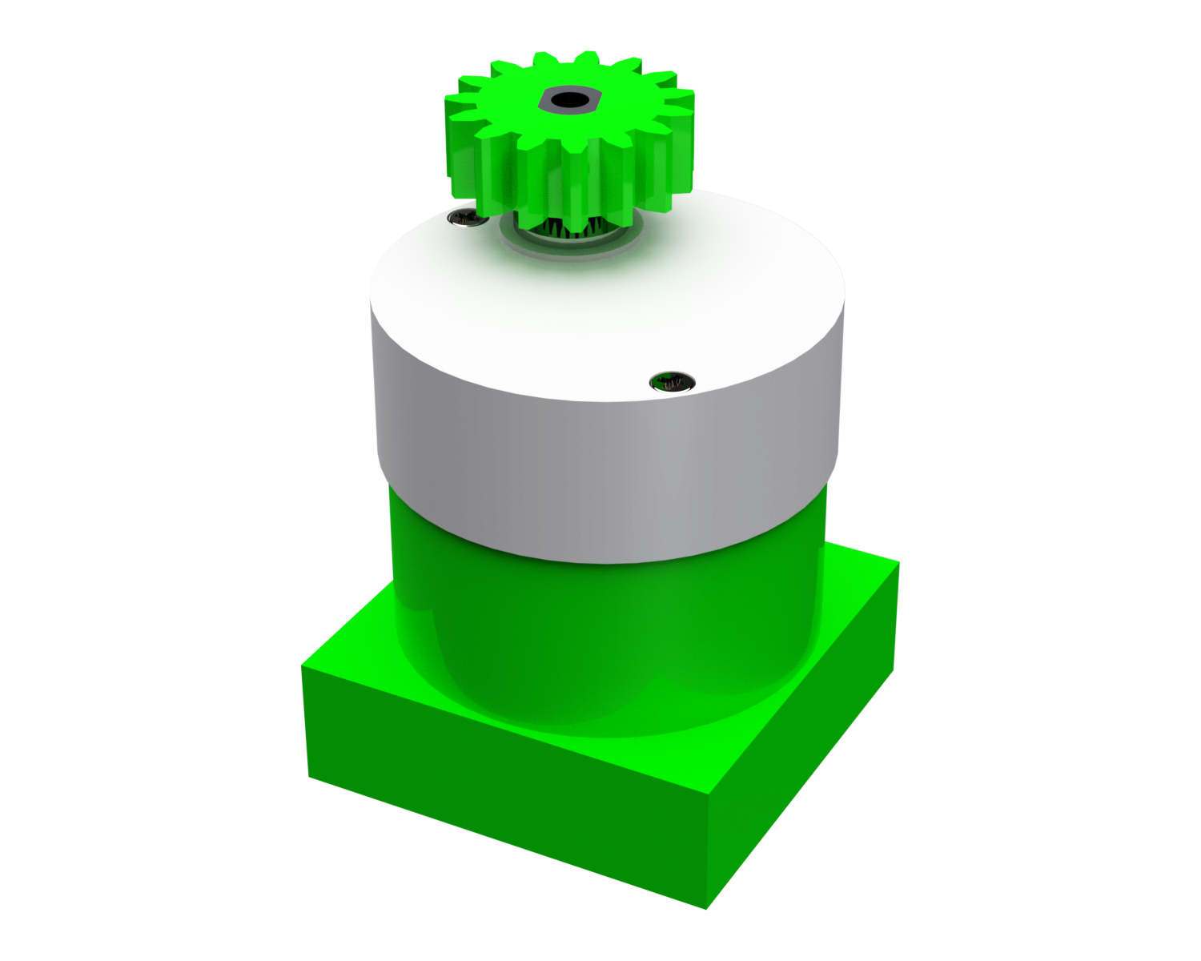
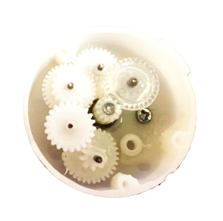
Lesson 4 – Motors & Gears
Lesson length: 60 Min
Key Learning: Structures & Forces
NGSS Area: K-2-ETS1
Seymour Says: These motor circuits get me all geared up!

Slide 31
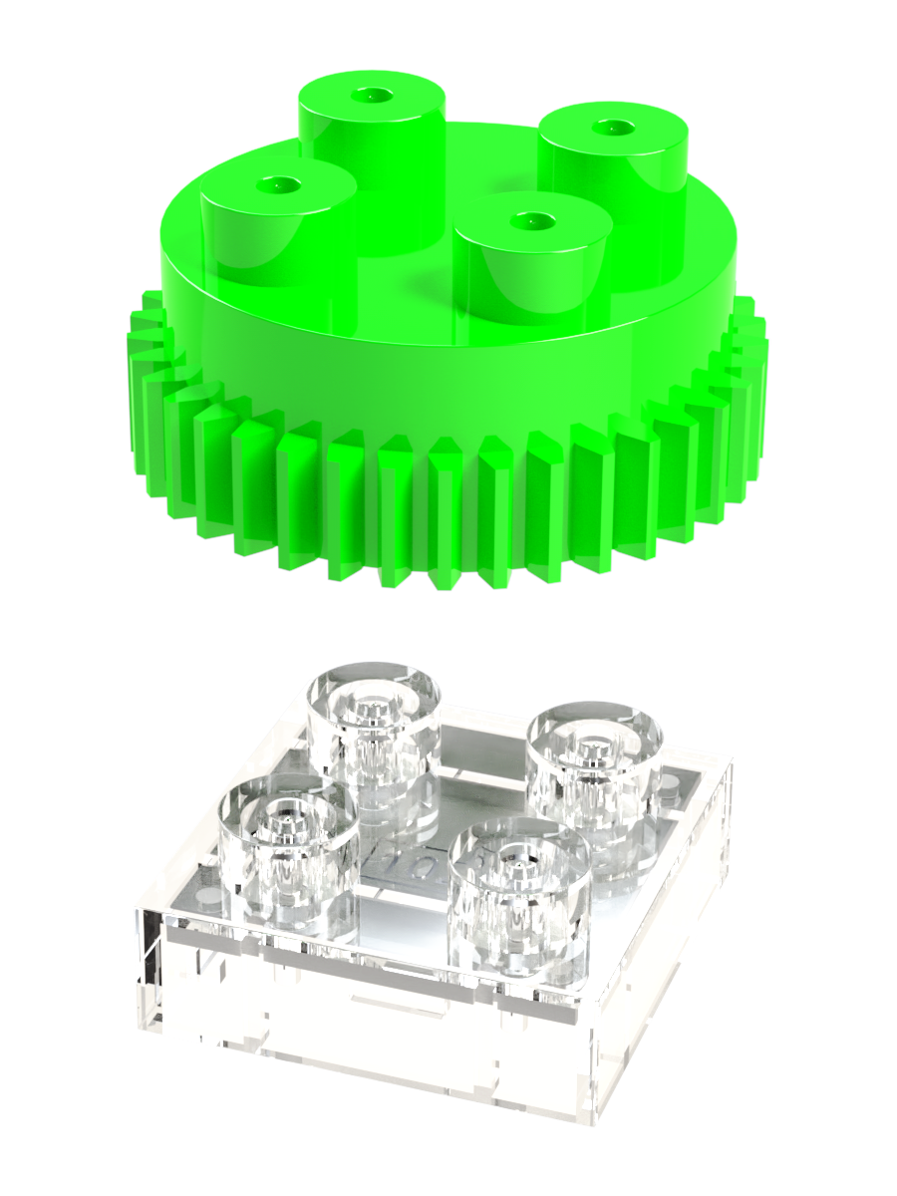
Gears
A gear is a part having teeth, or cogs, which can mesh with another toothed part to transmit torque.
By having different size parts, gears can change the speed, torque, and direction of a power source.
Assuming circular gears, it can be shown that the speed ratio (or gear ratio) is inversely related to the ratio of the radius (called the pitch radius) of the two gears engaged. So, going from a large radius gear to a small radius gear increases speed, and vice versa.
Some common applications for gears are food processors, printing machines, and factory automation.
Seymour Says:
The three main usages of gears are to change/increase speed, increase force, and change direction.
Your car uses helical gears. The leading edges of the teeth are set at an angle relative to the axis of rotation. This makes the gear curved to form the shape of a helix. The benefits of helix gears are improved strength and reduced noise in power transfer.
The Gear module in the Circuit Blox Lights ‘N Motion classroom set enables a light structure of Universal Lamps (35 and 102) to rotate at a much slower speed than the motor speed. The Gear module connects directly on top of a Universal Lamp (35 and 102) as shown on the upper right, and Universal Lamps (35 and 102) can connect directly on top of the Gear module.

Slide 32
Geared Motor Part Number 106
This is what the inside of the top part of the Circuit Blox Geared Motor (106) looks like!
The Geared Motor (106) module converts electrical energy to mechanical energy.
Current flows through the motor when connected to the Battery (91B).
This results in rotating the shaft of the motor.
The main shaft of the motor actually rotates much more quickly than the small gear attached to the top of the geared motor as there are several gears inside the geared motor that reduce the rotational speed (see picture to the right of the inside of the Geared Motor (106) module).
Seymour Says:
The Geared Motor (106) converts electrical energy (current through the module) to mechanical energy (shaft spins).
Larger gears spin more slowly when paired with smaller gears. This is how the speed of the motor shaft can be changed.

Slide 33
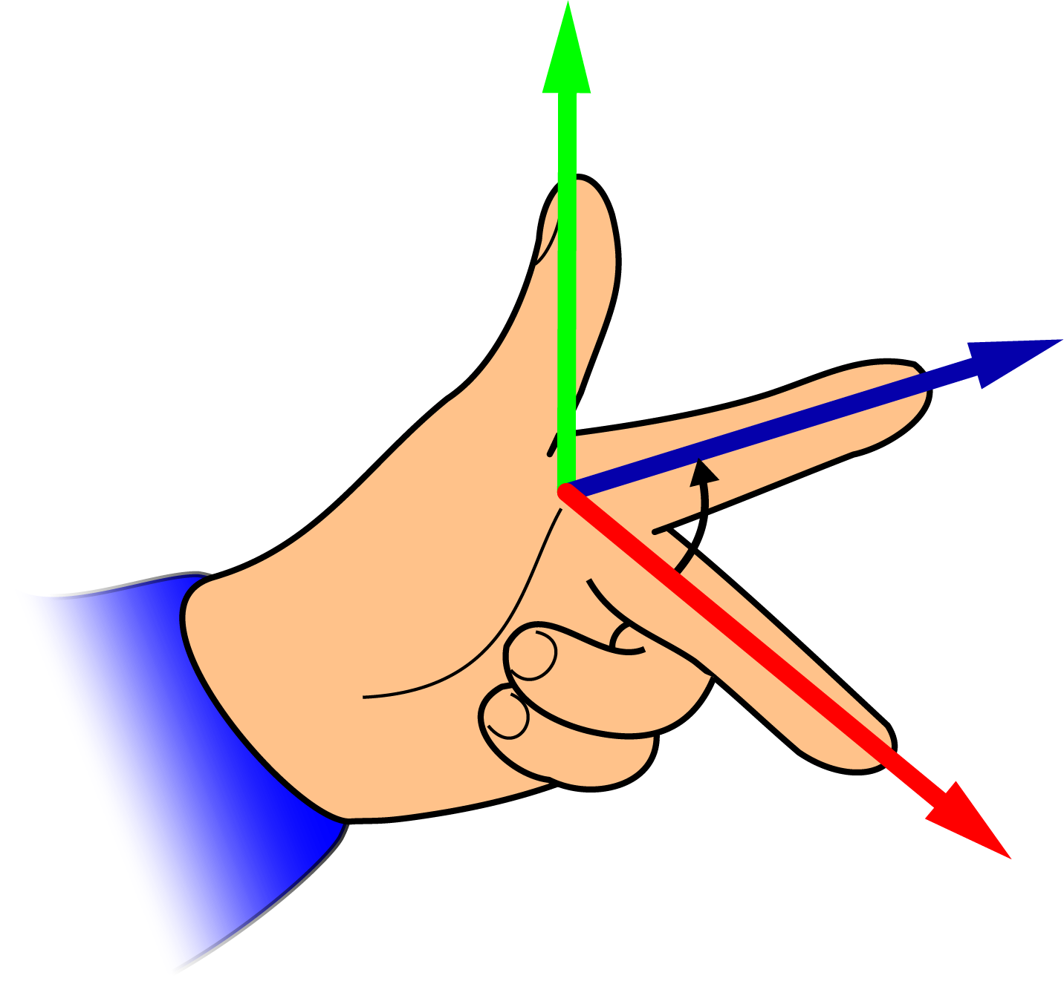
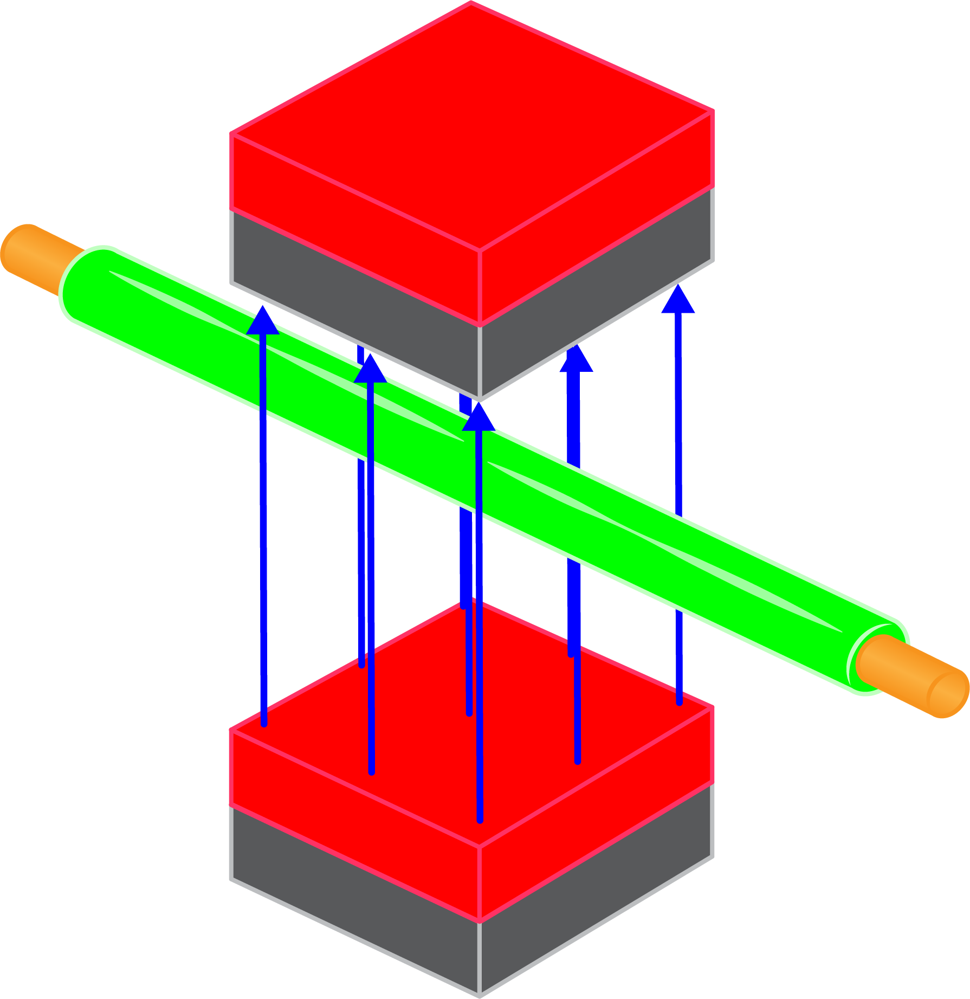
Details on Motors
M
Symbol for Motor
A motor converts electricity into mechanical motion.
The symbol for a motor is shown to the right.
In order to understand how a motor converts electrical energy to mechanical energy, we first must discuss how electricity and magnetism can create a force.
Force
Magnetic Field
Fleming’s Left Hand Rule states that when current flows through a conducting wire, and an external magnetic field is applied across that flow, the conducting wire experiences a force perpendicular both to that field and to the direction of the current flow (i.e., they are mutually perpendicular).
Current
You can use your left hand to implement this rule by pointing your index and middle fingers perpendicular to each other and pointing your thumb up in the air (see figure to the right).
Magnetic Field
Now consider the figure to the lower right, where current is running through a wire that is placed in a magnetic field created by two magnets. If you created this setup, then Fleming’s Left-Hand Rule says that the wire would start moving in the direction shown in the figure.
Force
Current
Seymour Says:
Fleming’s Left-Hand Rule applies when using the conventional definition of current. There is a Fleming’s Right-Hand Rule that applies when using the “Electron Flow” definition of current.

Slide 34
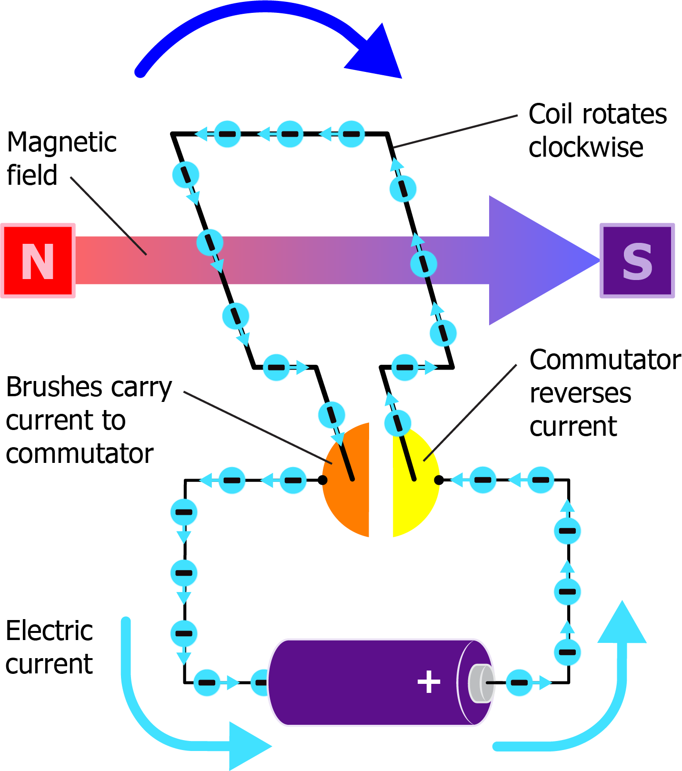
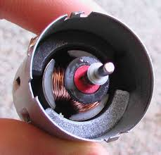
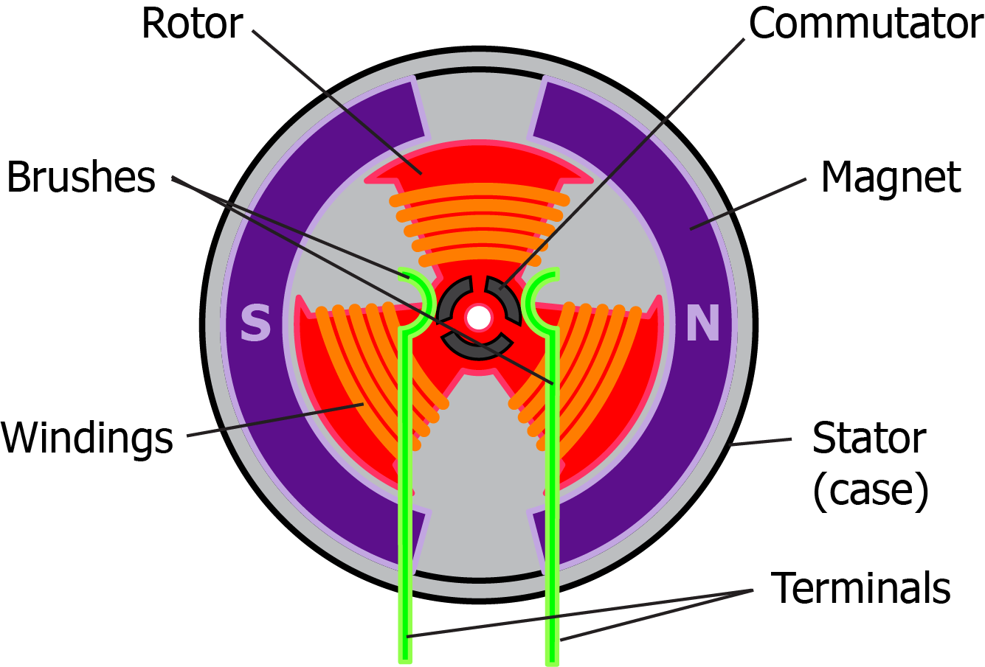
Details on Motors
This is what the inside of the bottom part of the Circuit Blox Geared Motor (106) looks like!
Based on Fleming’s Left-Hand Rule, we can now study how a motor works.
The figures to the right show a typical motor design. Note how a motor includes two polarized magnets to create a magnetic field across a coil that is wound around a rotor that can rotate.
This shows that by creating a loop with the wire, the magnetic field across the wire loop pushes the left side of the wire loop up and the right side of the wire loop down, causing the wire loop to rotate clockwise. This same effect occurs in the windings in the motor shown to the right when current is run through the motor.
Note that as the wire loop rotates, it will eventually reach a point where the current is moving downward near the South magnetic pole and upward near the North magnetic pole. Fleming’s Left-Hand Rule in this case says that the wire loop should rotate in the counterclockwise direction. However, motors use commutators to reverse the current through the windings before this situation occurs.
Brushed Motor Cross-section
All this is happening inside your Geared Motor (106) as shown to the right.
Seymour Says:
Commutators are used in motors to reverse the flow of current at just the right rotor location so that the force created by the magnetic field in the motor continues to rotate the rotor in the same direction.

Slide 35
Rotation through Gears
Using the Circuit Blox Lights ‘N Motion Classroom set, build the structure to the right. Make sure to connect the Geared Motor (106) and Gear to the Battery Module (91B) as per the instruction sheets in your Circuit Blox Lights ‘N Motion Classroom set.
Notice how all of the Universal Lamps (102) are connected to at least two connection points to the Universal Lamp(s) (102) below them as discussed in section 2.
As long as there is a path through the Universal Lamps (102) to the Battery (91B) through the Gear, then the LEDs in the Universal Lamps (102) will light.
The yellow arrows show how current flows from the Battery (91B), through four Universal Lamps (35), through the Gear, through the LEDs in the Universal Lamps (102), back to the Gear, back through the four Universal Lamps (35), and ultimately back to the Battery (91B).
The Geared Motor (106) is also connected to the Battery (91B) allowing current to flow through it which makes the gear on the top rotate.
Seymour Says:
Recall from slide 21 that the diagonally located connectors on the LED Modules (35 & 102) are electrically the same point.
The gear on the top of the Geared Motor (106) causes the bigger Gear to the right to rotate, which makes the whole light sculpture rotate. Do the two gears rotate at the same speed or does one rotate faster than the other?

Slide 36
Fun STEAM Exercise
Take the LEDs (102) of the Gear in the previous experiment and watch the two gears rotate. Which one is rotating faster, and why?

Slide 37
Lesson 4 – Quiz
Q: Which of the following is true of electric motors?
Turn mechanical energy into electrical energy
Turn electrical energy into light energy
Turn electrical energy into mechanical energy
Q: Which of the following is generally NOT a component you will find inside a motor?
A. Magnet B. Coil of wire C. LED
Q: What of the following is a usage of gears?
A. Change/increase speed B. Increase force C. Change direction D. All are usage of gears.

